Slide 1
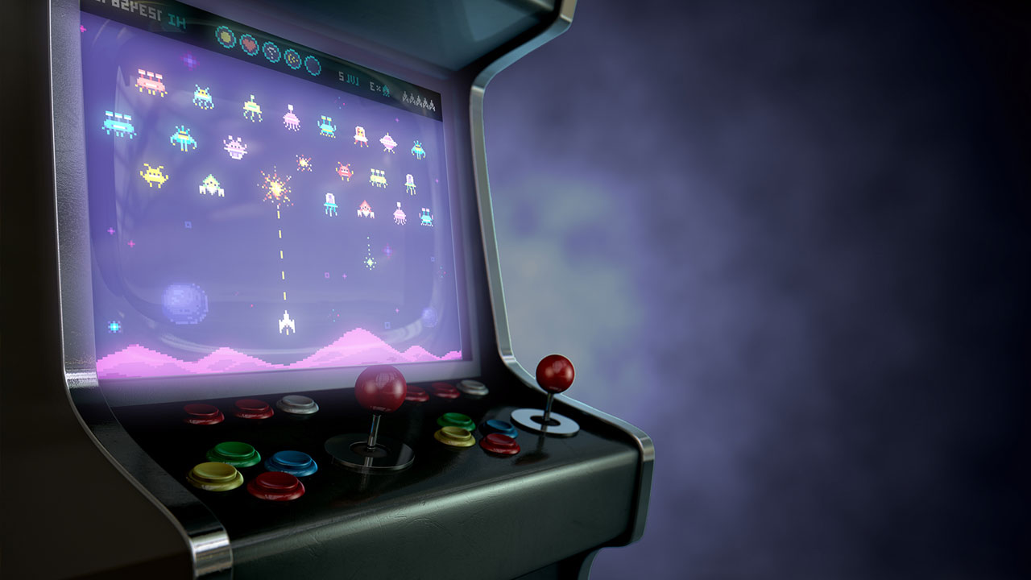
Interactive text-based game on Raspberry PI
By Ignacio Gonzalez, Timothy Wood and Andrew Garcia

Slide 2
Table of contents
01
04
02
05
03
06
Timeline
Challenges
Class Concepts
Improvements
Mechanics and Code Overview
Demo

Slide 3
Timeline
Define the project's scope, objectives, and requirements.
Arrange the different user-based decision pathways and flow of the program
Start setting up the main environment
Introduce multithreading and multiprocessing to handle different aspects of the game
Develop core game logic, setting, and features
Implement time-based events and test synchronization of multithreading
Implement and develop user interface for displaying all the game information and features
Refinement and implementation of final details, and Testing

Slide 4
Class Concepts
Locks | Creation of a lock for shared file, which allows both game scripts to communicate by reading file and writing to it.
Multiprocessing | We have 2 separate processes running, one of the Game and the other for the Map and Performance.
Multithreading | Having separate threads that control different aspects of the game
Synchronization Performance | Coordination of concurrent threads , which results in checking for overhead, lock contention, shared data protection and false sharing.

Slide 5
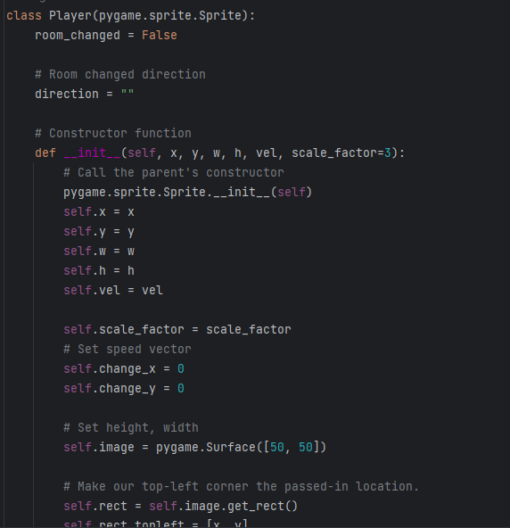
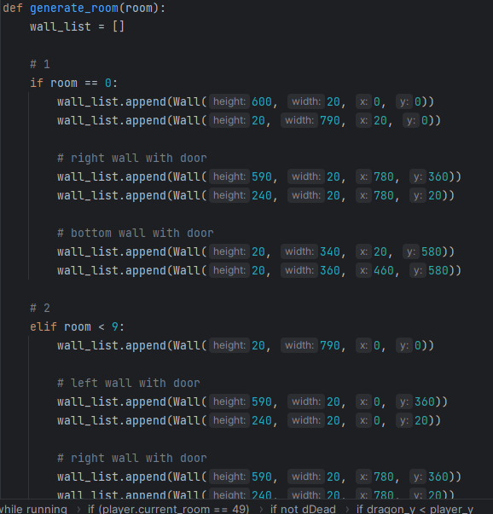
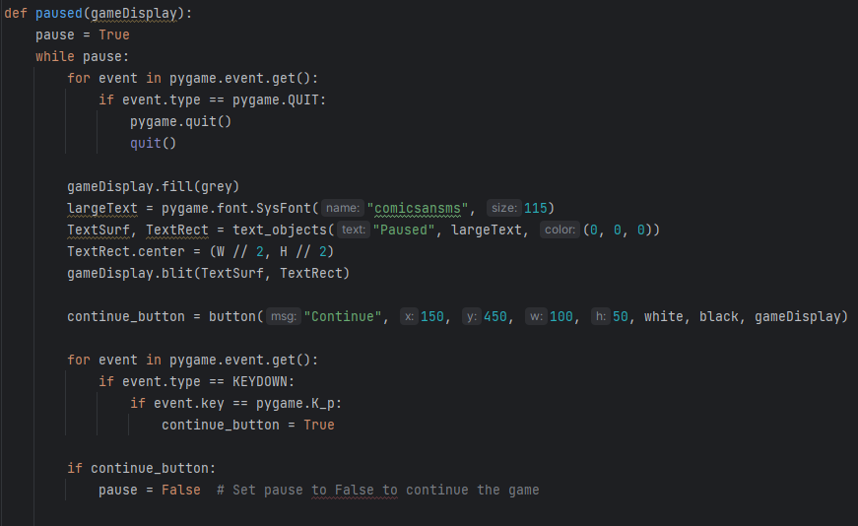
Mechanics and Code Overview
First step of our program is to create all global variables and all other methods that will operate outside the game loop.
Which includes creating the walls in the room, loading the images, method for pausing game, drawing health bars, etc.
Along with player and wall classes

Slide 6
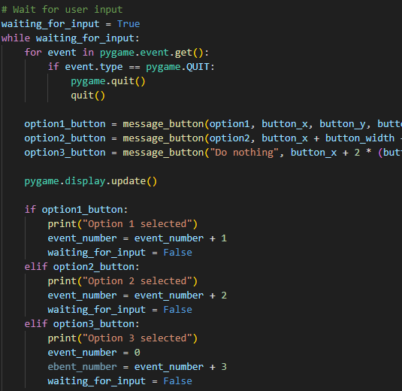
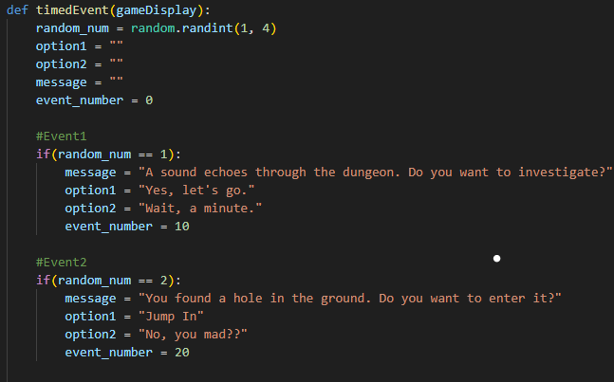
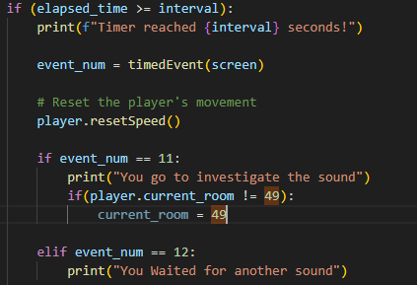
Mechanics and Code Overview
In these sections we handle the events generation and user decisions.

Slide 7
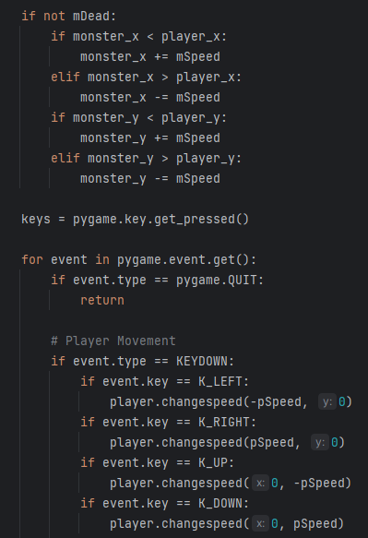
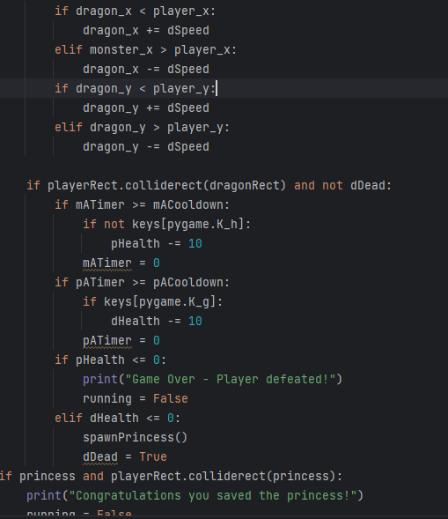
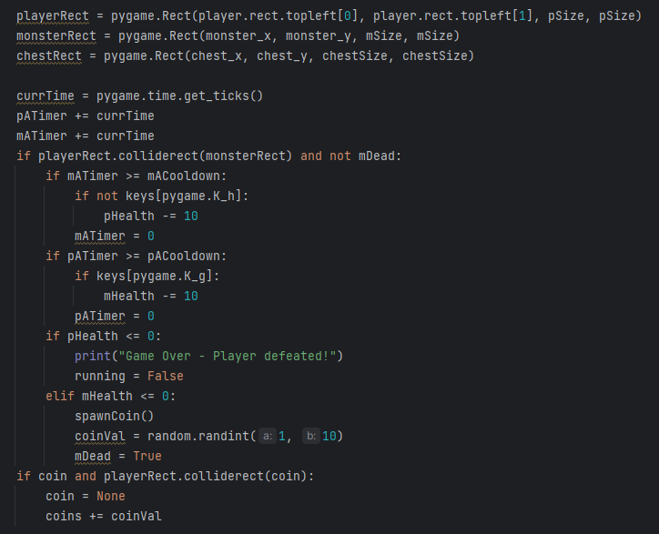
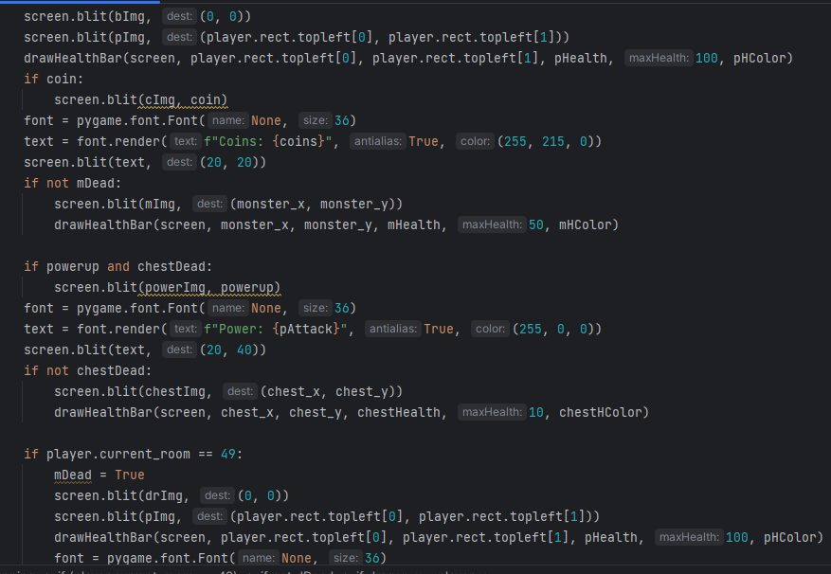
Mechanics and Code Overview
Inside the game loop we have all the movement and collision for the player, monster, boss, coin, chest, and princess. Along with attacking and blocking
This is where we also draw all our items

Slide 8
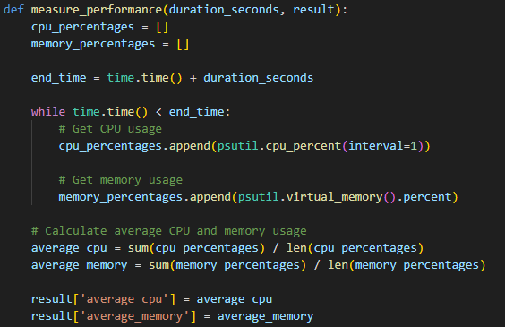
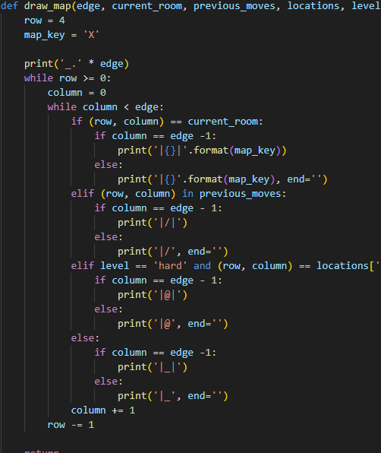
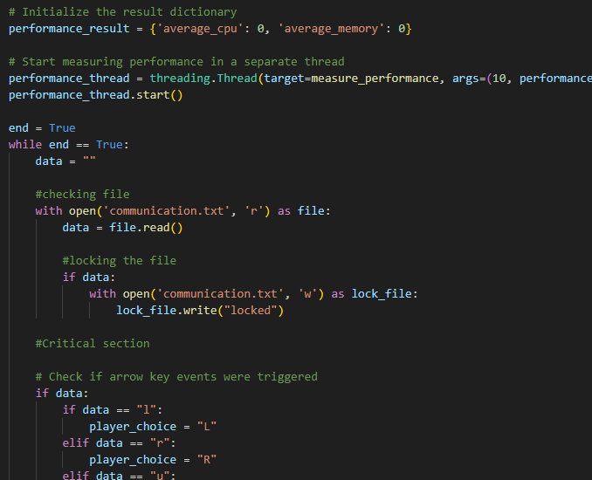
Mechanics and Code Overview
Map.py Code:
Performance Thread, File Communication, and Map/Location Output.

Slide 9
Challenges
Syncronization and Multiprocessing
Player Movement and in-game Mechanics
Rooms design and Monster Spawns
This was a big challenge as it took a big amount of time to set up. Also, because of the limitation of the Raspberry Pi, we had to remove some features and threads.
Collision between all entities was challenging to implement
Changing player speed through powerups
Rooms transition was challenging as it had to keep player current stats, also spawning enemies had to be implemented correctly so it did not affect game overall performance.

Slide 10
Improvements
An actual game engine instead of using pygame would improve the game vastly and development time
Adding animations for attacks and movements
Enhancing performance on Raspberry pi or using different hardware.
Scalability, making changes became harder in latest steps of the implementation.

Slide 11
Demo

